Slide 1
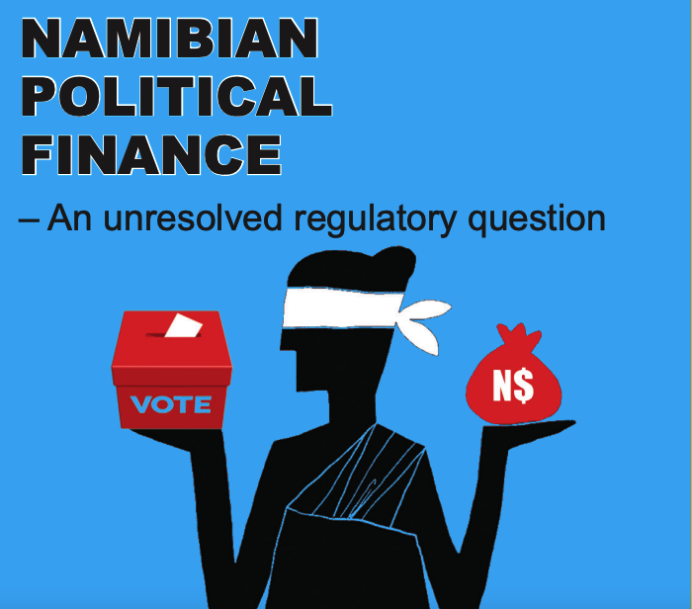

A Thorny Issue: Political Finance in Namibia
By Frederico Links
Research Associate
Institute for Public Policy Research (IPPR)
Namibia
19 June 2025

Slide 2

The issue

Slide 3
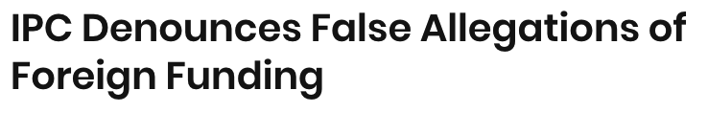


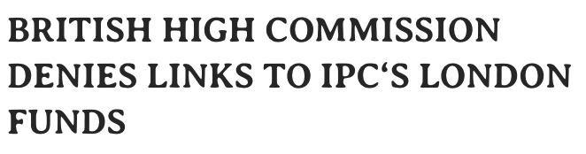
The issue

Slide 4
Background
– State started funding political parties with representation in parliament in 1997 following the issuing of a Cabinet resolution in 1996;
– The system uses a formula applied to the number of votes garnered and seats held by a political party to determine the amount of money that would flow to a specific political party.

Slide 5
Political finance in law
– Electoral Act 5 of 2014.
– Sections 139, 140, 141, 142, 154, 155, 156, 157, 158, 159, 160, 161.
– Government Notice 357 of 2019: Regulations relating to Declaration of Assets and Liabilities of Political Parties and Disclosure of Foreign and Domestic Financing of Political Parties, Organisations, Members or Other Persons.
– Government Notice 275 of 2020: Amendment of Government Notice No. 89 of 1 June 2015: Determination of formula for funding of political parties, percentage of unspent monies that may be retained by political parties and ancillary matters: Electoral Act, 2014.
Notes:
http://www.lac.org.na/laws/annoSTAT/Electoral%20Act%205%20of%202014.pdf
https://www.lac.org.na/laws/2020/7385.pdf

Slide 6
Political finance in law
Articles 139 to 142 apply to all registered political parties, irrespective of whether they have representation in parliament;
Articles 154 to 161 apply to only those political parties represented in parliament;
Articles 139, 140, 141 and 158 obligate political parties to keep proper records, to submit such records to the electoral commission, and to make such records public in prescribed forms and by set deadlines.

Slide 7


Dollars & cents

Slide 8
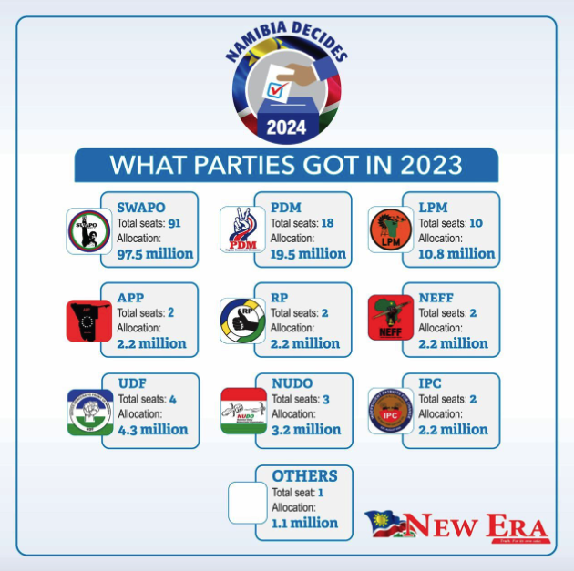
Dollars & cents

Slide 9
Perennial challenges
Wholesale lack of transparency and accountability;
Politicisation of the issue;
Culture of non-compliance;
Lack of trust in the electoral management body;
Passive compliance enforcement and oversight;
Accounting and auditing capacity weaknesses in political parties;
Oversight institutional arrangement.

Slide 10
Recommendations
Release of state funds should be made conditional on the satisfactory accounting and auditing of previous state funding to a particular party;
Oversight of the funding system should be by an independent electoral management body and the Auditor-General should have a role in checking party spending;
Political parties should strengthen their accounting and financial reporting capacities and develop sound policies regarding internal and external disclosure of financial matters.

Slide 11
Reference links:
Promoting Transparency and Accountability of Political Finance in the SADC Region: https://ippr.org.na/wp-content/uploads/2011/03/Namibia.pdf
Namibian Political Finance - An unresolved regulatory question: https://ippr.org.na/wp-content/uploads/2019/11/Political-Finance-amended.pdf
Political parties non-compliant on financial transparency: https://ippr.org.na/wp-content/uploads/2021/10/PoP-15-web-copy.pdf
Long-standing compliance issues cloud political finance: https://ippr.org.na/wp-content/uploads/2023/02/PoP-19-web.pdf

Slide 12
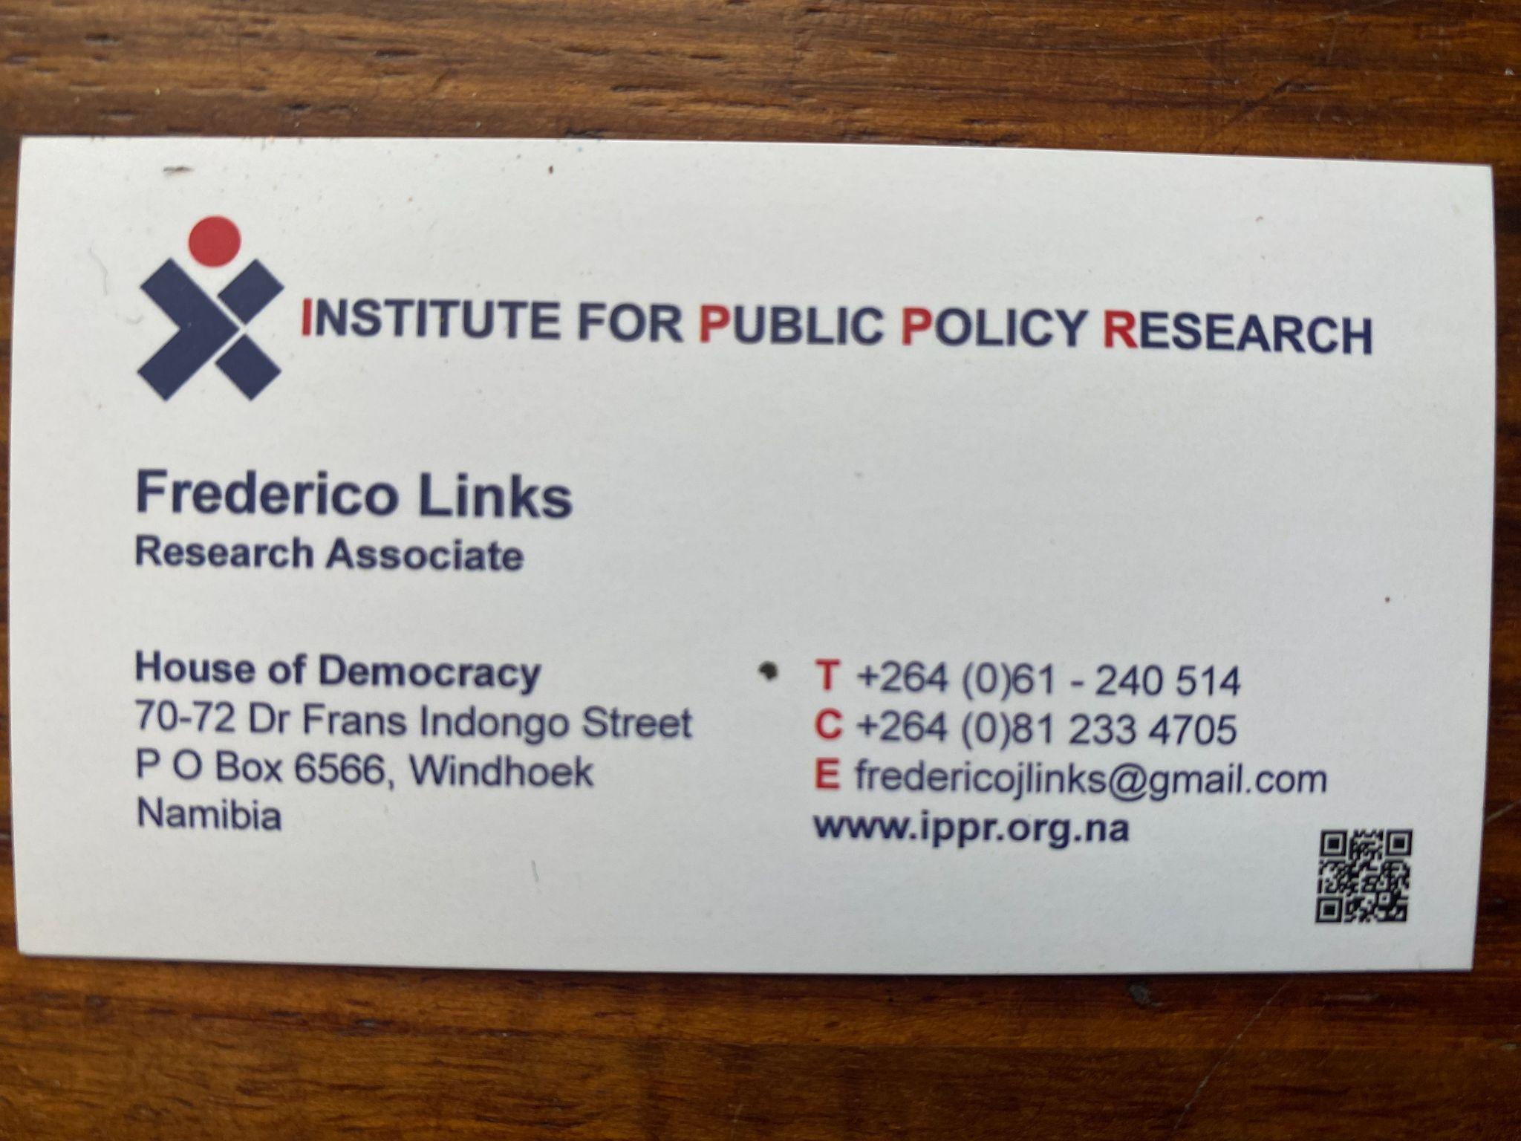
Contact me

Slide 13
Thank you!
Any questions or comments?

